Slide 1
CrimeInsight: Crime Data Pipeline and Business Intelligence System
Team Members :
S.NO | NAME | ROLL NUMBER
1 | Anakala Sarayu | 2420030249
2 | Manduri Varshitha | 2420030269
3 | Nidumolu Veda Samhitha | 2420030468
Faculty Guide : Dr. N Sirisha

Slide 2
Overview
Abstract
Introduction
Objectives
Literature survey

Slide 3
Abstract
CrimeInsight is a data engineering and business intelligence system designed to demonstrate the complete lifecycle of processing, storing, transforming, and analysing large-scale crime data. The system collects crime records from multiple source systems such as CSV files, open datasets, and simulated streaming sources, representing real-world heterogeneous data generation. A structured data architecture is designed to support reliable data ingestion, scalable storage, data modeling, transformation, and analytical processing.
The project implements batch-based data ingestion to collect raw crime records and stores them in a raw data layer before applying validation, cleansing, deduplication, normalization, and transformation processes. The transformed data is modeled into structured datasets suitable for analytical workloads, following appropriate data modeling and storage principles. The pipeline demonstrates key data engineering considerations including data quality, schema consistency, scalability, fault tolerance, partitioning, and efficient storage.
The processed data is then loaded into an analytical storage layer where business intelligence techniques are used to identify patterns such as crime frequency, geographic distribution, temporal trends, crime categories, and changes across different periods. Interactive dashboards and reports provide meaningful insights from the processed datasets. The project therefore demonstrates major stages of the Data Engineering Lifecycle, including source systems, data generation, ingestion, storage, data modeling, transformation, processing, and analytics. CrimeInsight provides a practical implementation of modern data engineering concepts while demonstrating how well-designed data pipelines can convert raw data into reliable and actionable information.

Slide 4
Introduction
The rapid growth of digital reporting systems has led to the continuous generation of large and diverse volumes of crime-related data from multiple sources.These datasets may arrive in different formats and can contain missing values, duplicate records, inconsistent fields, and other data quality issues. Without a proper data engineering pipeline, processing such data efficiently and preparing it for analysis becomes difficult. Data engineering provides the architecture, tools, and processes required to collect, ingest, store, process, transform, and organize raw data into reliable information.
CrimeInsight is an end-to-end data engineering and business intelligence system designed to process crime data and demonstrate the complete data engineering lifecycle. The system uses Python to generate and prepare realistic crime records, while Apache Kafka enables continuous ingestion of crime events into the data pipeline. PostgreSQL is used for reliable structured storage of operational and processed data, and Apache Spark performs data cleaning, validation, transformation, filtering, and aggregation. Apache Airflow orchestrates the different pipeline stages and automates scheduled data processing, while dbt is used to organize analytical transformations and data models. The processed data is finally connected to Power BI to create interactive dashboards for analyzing crime categories, temporal trends, geographic distributions, and other patterns. Docker is used to provide a consistent environment for the project components. The system brings together essential data engineering concepts including source systems, data generation, data architecture, storage systems, real-time and batch ingestion, data processing, data modeling, transformations, data quality, orchestration, and business intelligence.

Slide 5
Objective
To design and implement a complete data engineering pipeline for collecting, processing, storing, transforming, and analysing large-scale crime data.
To collect crime data from multiple heterogeneous sources such as CSV files, open datasets, and simulated streaming sources.
To implement reliable data ingestion mechanisms for efficiently transferring raw crime data into the data storage environment.
To develop a raw data storage layer that preserves the original crime records before processing and transformation.
To perform data cleaning and preprocessing, including validation, duplication, normalization, schema validation, and handling of inconsistent or missing data.
To design an efficient data model and storage architecture that supports scalable analytical processing and efficient data retrieval.
To implement data transformation and processing techniques to convert raw crime records into structured, analysis-ready datasets.

Slide 6
Literature survey
Paper Ref | Link | Authors | Drawback | Future Work
[1] Crime Data Analysis Using Pig with Hadoop (2016) | Paper Link | Arushi Jain, Vishal Bhatnagar. | Uses a CSV-based historical dataset Limited to predefined crime analyses such as year, state, and crime type. | Performs broader data cleaning and transformation Extend analysis to a fully distributed Hadoop cluster and other sectors.
[2] Design and Analysis of Machine Learning Algorithms for the Reduction of Crime Rates in India (2020) | Paper Link | Shraddha Ramdas Bandekar, C. Vijayalakshmi | The analysis mainly focuses on murder as the dominant crime attribute, limiting analysis of other crime types. | Develop an optimization model to improve crime-rate reduction and decision-making.
[3] Towards spatio-temporal crime events prediction | Paper Link | Jawaher Alghamdi, Thair Al-Dala’in | Drawback: The model uses only historical crime data from 2014–2016, limiting its ability to reflect recent crime patterns. | We can improve this by using more recent and continuously updated crime data, allowing the system to provide more accurate and up-to-date crime predictions.

Slide 7
Literature survey
Paper Ref | Link | Authors | Drawback | Future Work
[4] Interpretable machine learning models for crime prediction | Paper Link | Xu Zhang, Lin Liu, Minxuan Lan, Guangwen Song, Luzi Xiao, Jianguo Chen | The model is tested only in one police-station area (XT Paichusuo) covering 7.42 km², so its results may not generalize to other cities or regions. | Expand the model to multiple cities/regions and use more diverse datasets so that the crime prediction model can work effectively across different geographical and demographic conditions.
[5] Crime Forecasting: A Machine Learning and Computer Vision Approach to Crime Prediction and Prevention (2021) | Paper Link | Neil Shah, Nandish Bhagat, Manan Shah | real-time crime forecasting is difficult to achieve reliably in practice because crime is a highly complex system. | Extend the model using larger, diverse real-world crime datasets to improve reliability and evaluate its generalization across different locations and crime patterns.
[6] Crime Prediction Methods Based on Machine Learning: A Survey | Paper Link | Junxiang Yin | Traditional linear models may have low accuracy when crime patterns are complex and non-linear. | Implement and compare multiple ML models to improve prediction accuracy for complex crime patterns.

Slide 8
Paper Ref | Link | Authors | Drawback | Future Work
[7] Multi-layer Data Integration Technique for Combining Heterogeneous Crime Data | Paper Link | Sadaf Ahmed, Monica Gentili, Daniel Sierra-Sosa, Adel S. Elmaghraby | The model can produce false negatives, potentially missing human trafficking cases. | Test different time-window lengths to improve prediction accuracy.
[8] A systematic review on spatial crime forecasting | Paper Link | O. Kounadi, A. Ristea, A. Araujo, et al. | Reliance on historical data may reduce the effectiveness of models when crime patterns change over time. | Incorporate continuously updated and recent data to better adapt to changing crime patterns.
[9] AA survey on crime analysis and prediction | Paper Link | Ashly Thomas, N. V. Sobhana | individual prediction techniques do not provide sufficiently accurate results when used alone. | Develop more effective models capable of handling the complexity and variability of crime patterns.
[10] Crime Prediction & Monitoring Framework Based on Spatial Analysis (2018) | Paper Link | Hitesh Kumar Reddy ToppiReddy, Bhavna Saini, Ginika Mahajan | The prediction is based mainly on location and date, so it does not consider many other factors that can influence crime occurrence. | Incorporate crime data and update the system frequently to improve the freshness and reliability of predictions.

Slide 9
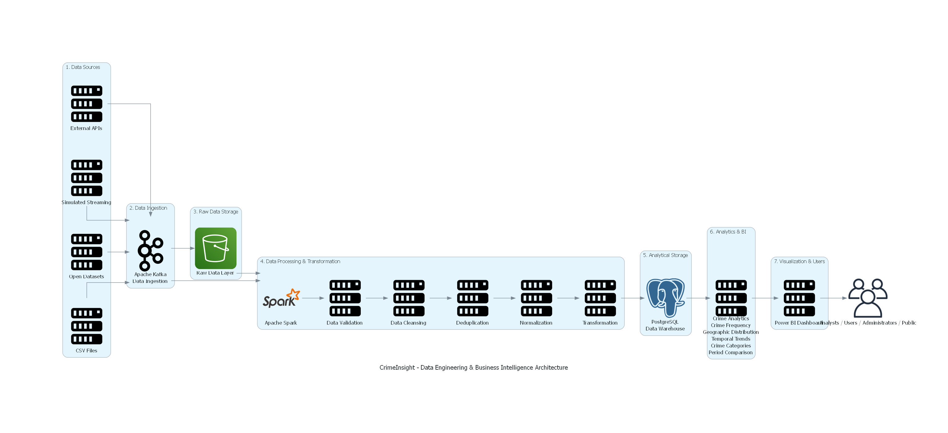
System Architecture

Slide 10
THANK YOU

